Slide 1

ABC Beverage PH Predictions
12.15.2024
DATA624
PRESENTATOR: Zig Dukuray, Natalie Kalukeerthie, Anna Moy, RIchie Rivera, Enid Roman

Slide 2
Mission Statement
This is role playing. I am your new boss. I am in charge of production at ABC Beverage and you are a team of data scientists reporting to me. My leadership has told me that new regulations are requiring us to understand our manufacturing process, the predictive factors and be able to report to them our predictive model of PH.

Slide 3

Introduction
For this analysis, we will use the provided historical data to build a model using the applicable techniques at our disposal.
We will attempt to predicatively estimate the PH of the manufacturing process at ABC Beverage.
Additionally, we will provide a forecast for "new" data provided.

Slide 4

Method
Conduct Exploratory Data Analysis (EDA)
Apply preprocessing to the data
Model Building
Ordinary Linear Regression
Partial Least Squares (PLS)
Neural Network Model
Multivariate Adaptive Regression Splines (MARS)
Support Vector Machines (SVM)
K- Nearest Neighbors (KNN)
Random Forest
Boosted Trees
Cubiest
Evaluate the models for each predictor and compare them to determine the best performance
Forecast model data into excel output

Slide 5
Model Preprocessing and EDA
Exploratory Data Analysis (EDA)
Identifying and determining the method for handling missing data
Understanding the variance of each predictor
Identifying the relationship between predictors and the response variable
Data Pre-Processing
Removing predictors with little to no variance in the data
Improve model efficiency and prevents overfitting
Conduct K-nearest neighbour imputation for missing data
kNN is more accurate imputation as it takes nearest neighbors for missing data compared to mean/median imputation
Split data into testing and training data
Avoids overfitting data and can perform validation on the model
Apply preprocessing to the testing and testing data
Transform the data for consistency and to remove outliers
Split training model into 80/20 split and model validation

Slide 6
Model building

Slide 7
Ordinary Linear Regression
The models we will build are:
Ordinary Linear Regression
OLR is a linear approach that models the relationship between the predictors and pH by minimizing the sum of squared residuals.
OLR Assumes linearity, independence, homoscedasticity, and normality of residuals.
One of the key features of OLR is the fact the no hyperparameter tuning required.
Performance: We give OLR a moderate performance grade. This model only captures linear relationships. As a baseline model, it was effective but this dataset demonstrated the need for a more sophisticated model.
## RMSE Rsquared MAE ## 0.1290943 0.4323892 0.1016434

Slide 8
Partial Least Squares (PLS)
b. Partial Least Squares (PLS)
The PLS model reduces predictors into uncorrelated components or latent variables explaining the variance in predictors and response variable. It is most useful for datasets suffering from multicollinearity.
A key feature of PLS is tuning is required regarding the number of components. There's a trade-off between dimensionality reduction and prediction accuracy exists.
Performance: We concluded that PLS is not significantly better than OLR.
## RMSE Rsquared MAE ## 0.1298032 0.4261621 0.1019854

Slide 9
Neural Network Model
c. Neural Network Model
A neural network model is exactly what it sounds like, NNM’s mimic biological neural networks to model complex nonlinear relationships. NNM’s Consists of layers of interconnected neurons.
Some key features of NNM’s are that they remove highly correlated predictors to reduce redundancy.
NNM’s are tuned with decay and size parameters.
Performance: The performance of the NNM model is it effectively captured nonlinear relationships. It does require careful tuning to avoid overfitting or underfitting.
## RMSE Rsquared MAE ## 0.12164761 0.50970105 0.09266492

Slide 10
Multivariate Adaptive Regression Splines (MARS)
d. Multivariate Adaptive Regression Splines (MARS)
MARS is a flexible regression method that uses piecewise linear basis functions to model non-linear relationships. MARS automatically selects relevant interactions and variables.
Some key features are MARS is tuned with degrees of interaction and number of retained terms (nprune). MARS is also capable of handling high-dimensional data effectively.
Performance: MARS performance was weaker compared to other models. This model is susceptible to overfitting with high degrees of freedom. It also highlighted the challenges of modeling pH levels with interactions.
## RMSE Rsquared MAE ## 0.13472022 0.41935348 0.09999733

Slide 11
Support Vector Machines (SVM)
e. Support Vector Machines (SVM)
SVM is a powerful non-linear method that finds the optimal hyperplane to separate data in high-dimensional space. It uses kernel functions to capture non-linear relationships.
Some key features of SVM is it utilizes a radial basis function (RBF) kernel used for non-linear separation. It requires tuning of cost and gamma parameters as well as handling outliers strongly by introducing slack variables.
Performance: SVM model resulted in strong performance with the ability to generalize well. This model is computationally intensive for larger datasets and is also effective in capturing non-linear dependencies.
## RMSE Rsquared MAE ## 0.1147053 0.5604292 0.0859519

Slide 12
K-Nearest Neighbors (KNN)
f. K-Nearest Neighbors (KNN)
KNN is a non-parametric method that predicts pH based on the average of the nearest k observations. It focuses on the principle of similarity-distance metrics between data points.
Some of the key features of KNN’s are it can handle computational expense of large datasets. It is tuned for optimal k value-Number of neighbors and is sensitive to noise and outliers.
Performance: The KNN model had a good balance between simplicity and efficiency. It also pointed out the relevance of tuning k for better predictions.
## RMSE Rsquared MAE ## 0.11957078 0.51936213 0.08987493

Slide 13
Random Forest
g. Random Forest
Random Forest is an ensemble learning method that constructs multiple decision trees and then combines their predictions for improved accuracy. RF handles nonlinear relationships and interactions effectively.
Some of the key features of RF is the ability to automatically determine important predictors. It is robust to overfitting due to averaging and can handle missing data and high-dimensional datasets.
Performance: The Random Forest model is the best overall performance among all models. The most important predictors according to RF are Brand Code, Manufacturing Flow, Pressure Vacuum. RF Demonstrated reliability and robustness in predicting pH levels.
## RMSE Rsquared MAE ## 0.09746611 0.69074149 0.07416578

Slide 14
Boosted Trees
h. Boosted Trees
Boosted trees is a generalized sequential ensemble method that builds decision trees iteratively to correct errors of previous models. It has a focus on minimizing bias.
Some of the key features of Boosted Trees are interaction depth, number of trees, and learning rate tuned. It also performs regularization to avoid overfitting.
Performance: The Boosted Trees model has competitive performance but is slightly less effective than Random Forest. It is quite useful for identifying subtle patterns in data.
## RMSE Rsquared MAE ## 0.09927913 0.66402274 0.07673660

Slide 15
Cubist
i. Cubist
The Cubist model combines linear regression models with rule-based decision trees for enhanced interpretability and accuracy. It is suitable for both regression and classification tasks.
Some of the key features of the Cubist model is it automatically generates rules based on predictors. It goes further by balancing interpretability and flexibility.
Performance: The Cubist model has the second best in performance after Random Forest. One of the most important components is it is highly interpretable and useful for actionable insights.
## RMSE Rsquared MAE ## 0.09719990 0.67862646 0.07120253

Slide 16
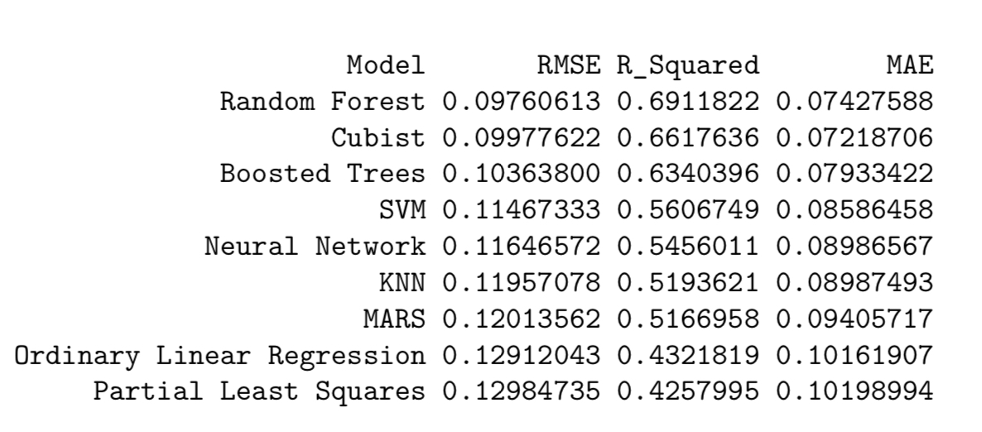
Model Evaluation and Selection
For evaluating our models we elected to use R squared as our rating metric. Comparing the R squared scores we see that the random forest model has the best score. This score essentially says that we can be confident that about 70% of the factors which contribute to PH are contained in our data for predictions.
Because of this we’ve elected to select the Random Forest model as it is our best performing model. Results from this model should be used to help guide outcomes and anything flagged by the model should warrant more investigation.

Slide 17
Conclusion and Results
The Random Forest model has proven to be an effective and reliable tool for predicting pH levels within ABC Beverage's manufacturing process. By analyzing historical data, we identified key factors that influence pH levels, providing a deeper understanding of the manufacturing process. This knowledge will allow for proactive adjustments to ensure product consistency and compliance with regulations.
The predictive accuracy of approximately 70% highlights the model's capability to anticipate pH variations and support operational decisions. Key insights, such as the significance of "Brand Code" and "Manufacturing Flow," can inform targeted process improvements, minimizing variability and enhancing efficiency.
Furthermore, the model has practical applications for real-time monitoring of pH levels, offering a mechanism for early detection of potential issues. This capability reduces downtime and waste while ensuring high-quality production standards are maintained. The Excel-based forecast ensures the model's seamless integration into existing workflows, providing stakeholders with accessible and actionable information.

Slide 18
The Random Forest model not only fulfills regulatory requirements but also provides a roadmap for continuous improvement in production processes. By understanding and leveraging the drivers of pH variability, ABC Beverage can maintain its commitment to product excellence and operational efficiency.
Recommendations:
Integration: Embed the model into routine operations for continuous monitoring and adjustments.
Investigation: Use flagged predictions to explore underlying issues, ensuring swift corrective actions.
Continuous Improvement: Periodically update the model with new data to maintain accuracy and relevance.
Training: Provide training for staff to effectively utilize insights from the model in daily operations.
We are confident that these findings and recommendations will empower ABC Beverage to meet its regulatory obligations, improve manufacturing efficiency, and maintain high standards of product quality. Please reach out for any further support or clarification.

